Slide 1
THE METRIC SYSTEM

Slide 2
What do Americans use?
Here in the US, we use the customary system of measurement
Cups
Feet
Inches
Pounds
Ounces
Its confusing and hard to work with
12 in = 1 ft
3 ft = 1 yard
1 mile = 5280 ft
16 oz = 1 lb
2000 lb = 1 ton
1 gallon = 256 Tbsp
3 tsp = 1 Tbsp

Slide 3
Wouldn’t it be nice if……?
There was a system of measurement that was universal and easier to work with?
The only number you needed to remember was 10?
Like 10 pennies = 1 dime, 10 dimes = 1 dollar, 10 dollars = 1 ten dollar bill, 10 ten dollar bills = 1 100 dollar bill, etc.
All you needed to make conversions between small and large units was a staircase and your finger? Instead of a calculator and a conversion chart?

Slide 4
GUESS WHAT?????
 There is a system of measurements that does all of these things…..
The METRIC SYSTEM!!!!!!!
Or the SI units of measurement in the scientific world.

Slide 5
WHAT ARE THE THREE BASIC UNITS OF MEASUREMENT?
The meter measures the length of an object or the distance from place to place
The liter measures volume (liquids and solids) or how much space is occupied.
The gram measures mass or how much matter does an object possess.

Slide 6
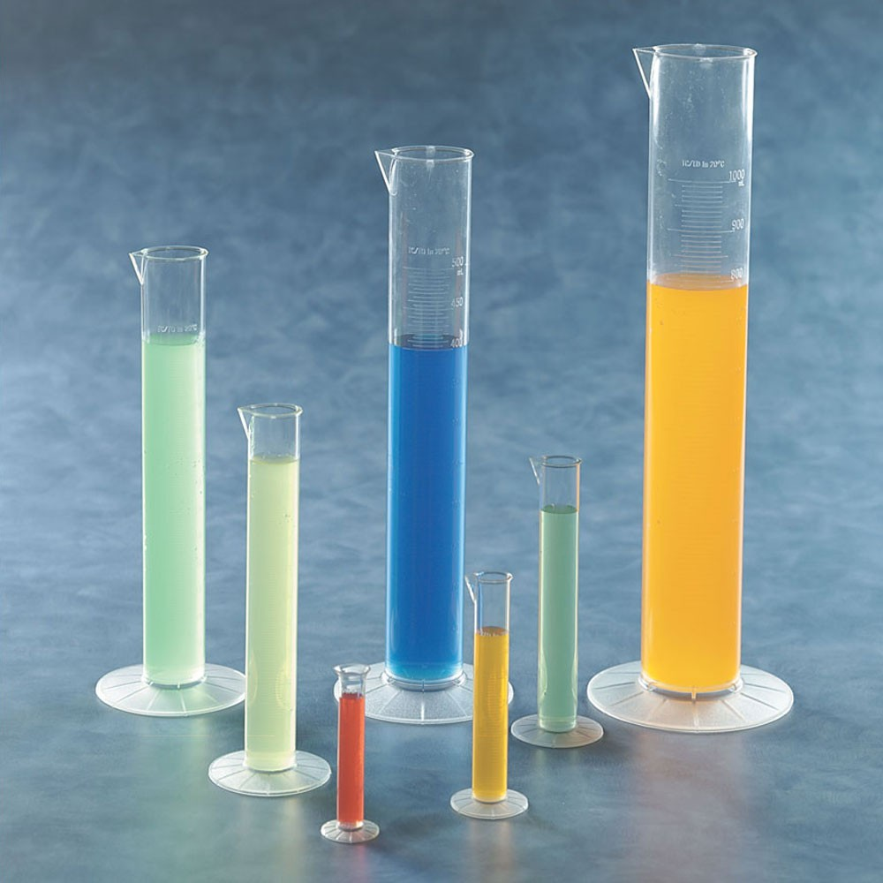
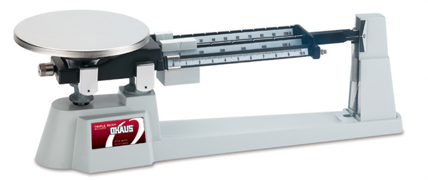
TOOLS of the METRIC SYSTEM
Meterstick: measures length
Kilometer, meter, centimeter, millimeter, micrometer
Triple-beam Balance: measures mass
Kilogram, gram, centigram, milligram
Graduated Cylinder: measures volume (liquids or solids)
Kiloliters, decaliters, liters, deciliters, centiliters, milliliters.

Slide 7
Length or distance: meter stick or ruler
4.30 cm

Slide 8
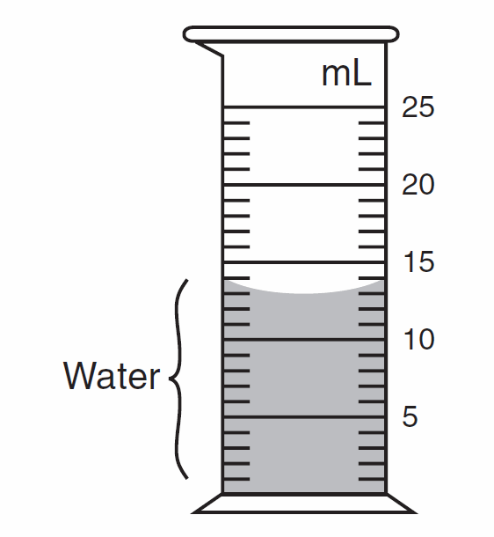
Volume: Graduduated Cylinder
13.0 mL

Slide 9
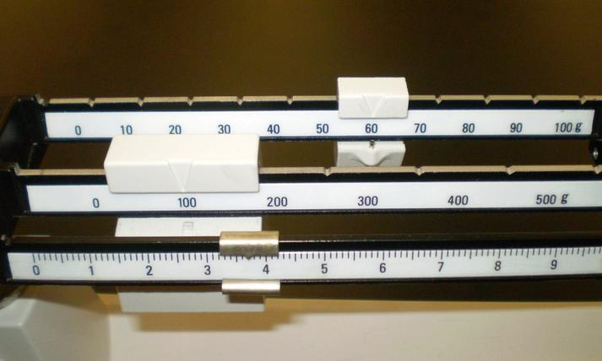
Mass: Triple Beam balance
163.7 g

Slide 10
So how do we convert between units?
Sometimes you will need to change from a smaller unit to a larger unit.
When adding/subtracting units together, they must be the same….
cm + cm, L + L, Kg + Kg
All you need to know is how to climb upstairs or downstairs, and point while saying
Kangaroos Hopping Down Mountains Drinking Chocolate Milk mmM.

Slide 11
kilo –
1000
hecto –
100
When getting smaller, move decimal to the right that number of steps or multiply.
deca –
10
Base unit
meter
Liter
gram
deci –
1 / 10
centi –
1 / 100
milli –
1 / 1000
When getting larger, move decimal to the left that number of steps or divide.
micro –
μ
1 / 1000000

Slide 12
Converting using the metric step
100 g = _______ mg
15kg = ________ g
1.5 dm = _______ cm
3780 mL = ________ L
2.1 mm = μm
100,000
15,000
15
3.780
2100

Slide 13
Length or distance: meter stick or ruler
4.30 cm
0.043 m
43.0 mm
0.000043 km

Slide 14
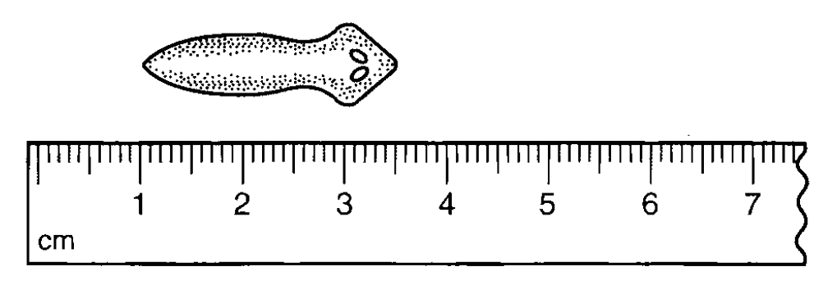
___?___mm
25 mm
___?___m
0.025 m
___?___cm
2.5 cm

Slide 15
Volume: Graduduated Cylinder
13.0 mL
0.013 L

Slide 16
Mass: Triple Beam balance
163.7 g
163700.0 mg
0.1637 kg

